Slide 1

Credit Card Fraud Detection
By
Dharani Reminisetti,
Pallavi Ramineni

Slide 2
Problem Statement
Credit card fraud is a serious issue that causes financial losses to both consumers and businesses.
Detecting fraudulent transactions accurately and quickly is difficult and complicated task.
The goal of this project is to implement a machine learning model that can identify fraudulent transactions using machine learning models.
A reliable fraud detection model can help prevent financial losses and protect customers from fraud.

Slide 3
Introduction
Our project Credit card fraud detection is a critical machine learning application that identifies unauthorized transactions in real time. We used supervised learning models (Logistic Regression, Random Forest, XGBoost, KNN, SVM) to classify transactions as fraudulent or legitimate.
Credit card Fraud costs businesses billions yearly. Our model detects scams fast protects revenue and keeps customers from losing faith in a brand.
We test our models with 4 different metrics(Accuracy, Precision, Recall, F1 Score, AUC-ROC)

Slide 4
Literature Review
Rule-based systems for credit card fraud detection use predefined rules and thresholds to flag suspicious transactions, such as those that deviate from normal spending patterns or exceed established limits.
Machine learning is often better than rule-based systems because it can automatically learn complex patterns and adapt to new, previously unseen fraud techniques.

Slide 5
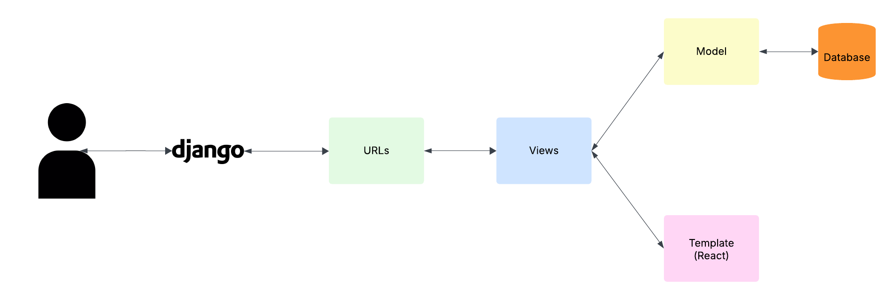
High Level Architecture

Slide 6
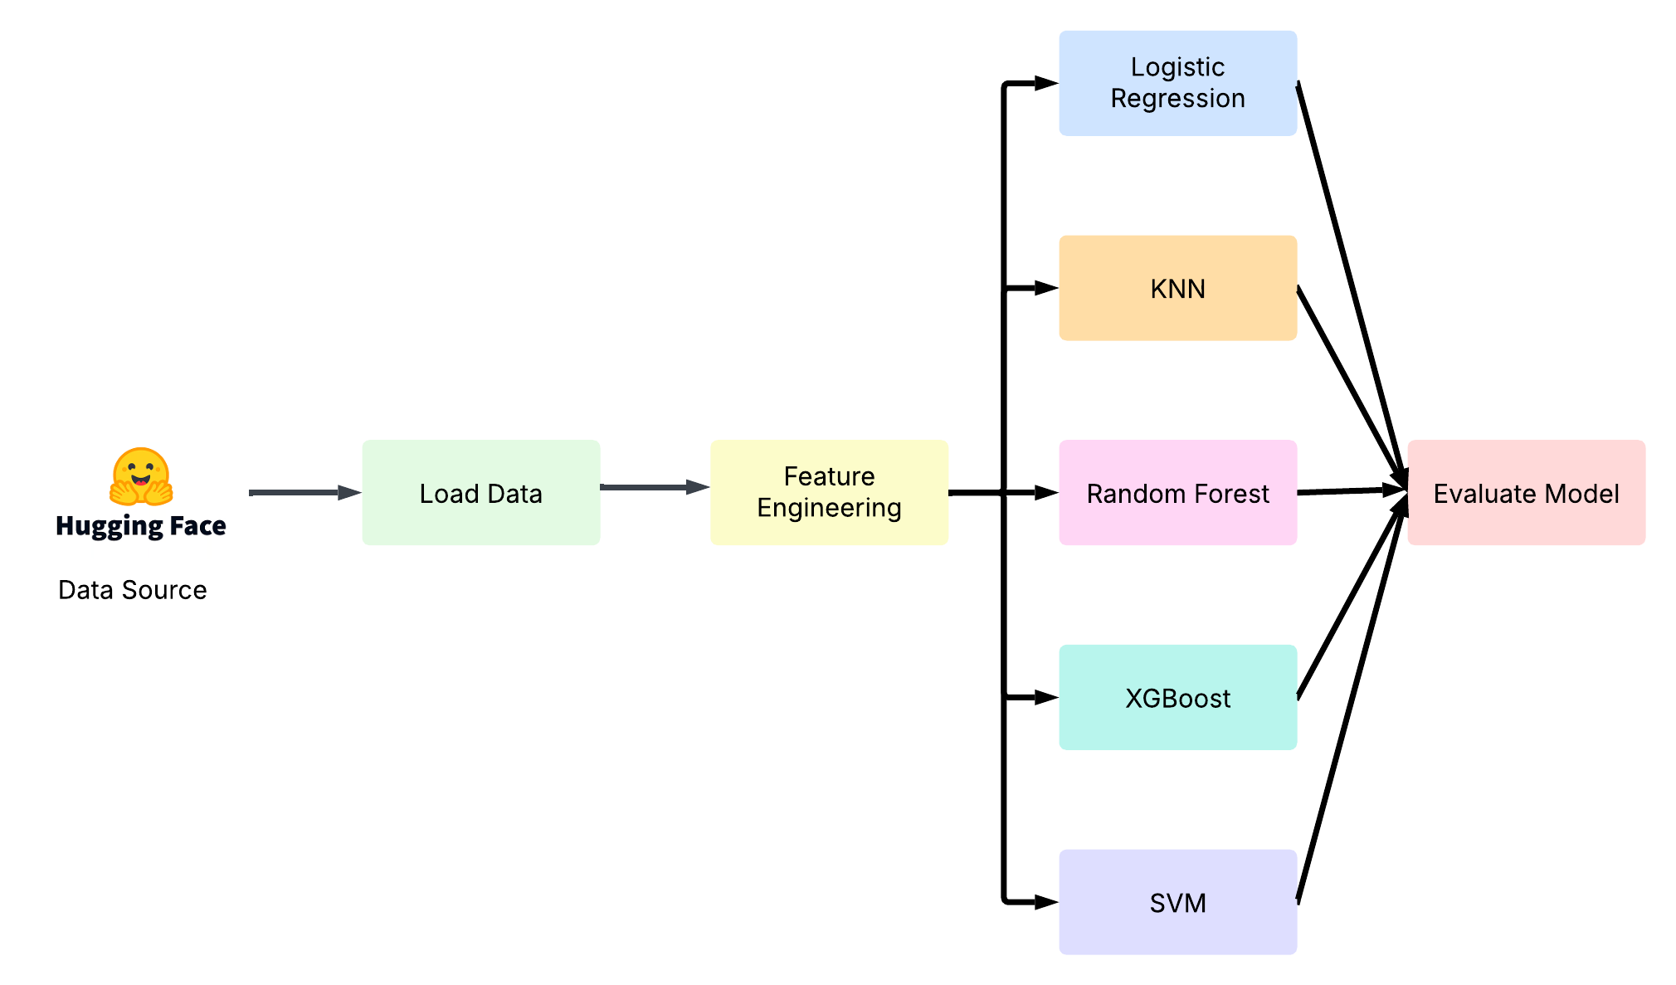
Model Architecture

Slide 7
MVP
Cleaned and transformed the dataset, handled missing values, applied reverse geocoding to get merchant county and state from the Latitude and Longitude, and extracted features hour, day, and month from the transaction time.
Encoded categorical features using LabelEncoder and scaled numerical features using StandardScaler.
Trained multiple models (Logistic Regression, Random Forest, XGBoost, KNN, and SVM) using an 80/20 train-test split.
Evaluated models on accuracy, precision, recall, F1 score, and AUC-ROC, and visualized the results with ROC curves for each model.

Slide 8
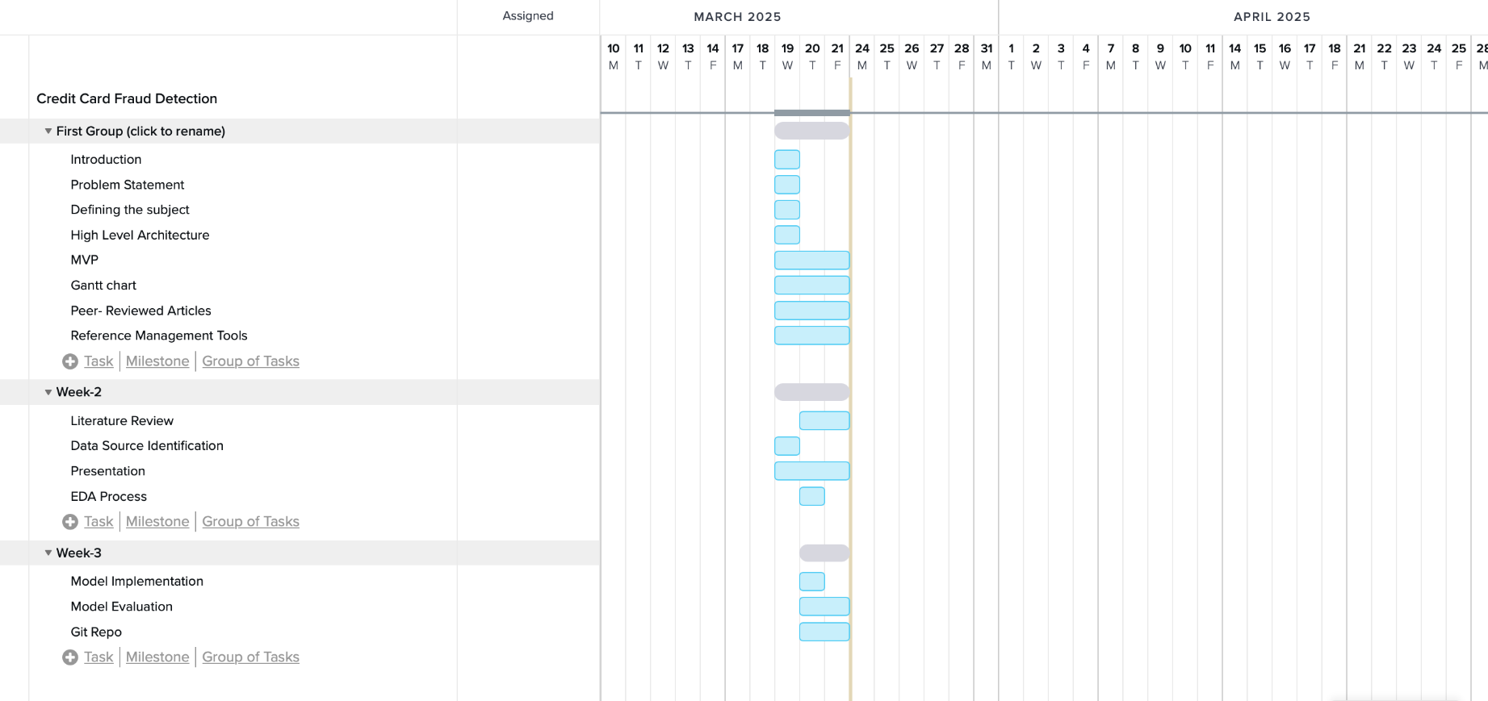
Gantt Chart

Slide 9
Models Implementation
The dataset is split into training and test sets with an 80/20 ratio, ensuring the model trains on 80% of the data and tests on 20% for evaluation.
Five different machine learning models are used: Logistic Regression, Random Forest, XGBoost, K-Nearest Neighbors (KNN), and Support Vector Machine (SVM).
Each model is trained on the training data, and predictions are made on the test data to evaluate their performance using various metrics.

Slide 10
Results
Model | Accuracy | Precision | Recall | F1-Score | AUC-ROC
Logistic Regression | 0.848333 | 0.923077 | 0.760000 | 0.833638 | 0.866933
Random Forest | 0.938333 | 0.93999 | 0.936667 | 0.938230 | 0.981717
XGBoost | 0.960000 | 0.953947 | 0.966667 | 0.960265 | 0.988100
KNN | 0.533333 | 0.532051 | 0.553333 | 0.542484 | 0.538017
SVM | 0.515000 | 0.512465 | 0.616667 | 0.559758 | 0.501161

Slide 11
Conclusion
Cleaned and transformed the dataset, handled missing values, and added new features like merchant county and state.
Trained five models (Logistic Regression, Random Forest, XGBoost, KNN, and SVM) and evaluated their performance using multiple metrics.
Random Forest and XGBoost performed the best, with high accuracy and AUC-ROC scores.
Going to deploy the project using Django with React for the frontend, and the database choice is still undecided.

Slide 12
References
Dataset:
https://huggingface.co/datasets/dazzle-nu/CIS435-CreditCardFraudDetection/blob/main/fraudTrain.csv
GeoPy:
https://geopy.readthedocs.io/
Rule based Models:
Leonard, K. J. (1995). The development of a rule-based expert system model for fraud alert in consumer credit. European Journal of Operational Research, 80(2), 350-356. https://doi.org/10.1016/0377-2217(93)E0249-W
Ahmed M, Ansar K, Muckley CB, Khan A, Anjum A, Talha M. A semantic rule based digital fraud detection. PeerJ Comput Sci. 2021 Aug 3;7:e649. doi: 10.7717/peerj-cs.649. PMID: 34435097; PMCID: PMC8356649.
Dirik, Mahmut. (2022). Predicting credit card fraud using multipurpose classification based on evolutionary rules. Security and Privacy. 5. 10.1002/spy2.239.
Kumar, Jaydip & Saxena, Vipin. (2022). Rule-Based Credit Card Fraud Detection Using User’s Keystroke Behavior. 10.1007/978-981-19-0707-4_43.
“A Rule-Based Machine Learning Model for Financial Fraud Detection.” International Journal of Electrical and Computer Engineering (IJECE), 2024.

Slide 13
https://www.researchgate.net/publication/367133523_A_supervised_machine_learning_algorithm_for_detecting_and_predicting_fraud_in_credit_card_transactions
https://www.researchgate.net/publication/360473262_Credit_Card_Fraud_Detection
https://www.researchgate.net/publication/371465537_Credit_Card_Fraud_Detection_using_Classification_Algorithm
https://www.researchgate.net/publication/339543849_Credit_Card_Fraud_Detection_using_Machine_Learning_Algorithms
https://www.researchgate.net/publication/379259523_Credit_card_transaction_fraud_detection_based_on_machine_learning
https://www.researchgate.net/publication/378297475_Credit_Card_Fraud_Detection_Comparison_of_Different_Machine_Learning_Techniques
https://www.researchgate.net/publication/385210498_Analysis_of_Different_Machine_Learning_Models_for_Credit_Card_Fraud_Detection
https://www.researchgate.net/profile/Kalyanapu-Srinivas-2/publication/359133295_Credit_Card_Fraud_Detection/links/6229a00a97401151d20b6602/Credit-Card-Fraud-Detection.pdf
https://www.researchgate.net/publication/371091453_CREDIT_CARD_FRAUD_DETECTION_USING_MACHINE-LEARNING
https://www.researchgate.net/publication/369857378_Credit_Card_Fraud_Detection
https://www.researchgate.net/publication/379657457_Comparative_analysis_of_machine_learning_techniques_for_credit_card_fraud_detection_Dealing_with_imbalanced_datasets
https://www.researchgate.net/publication/371678867_Credit_Card_Fraud_Detection
https://www.researchgate.net/publication/389103582_Multiple_Machine_Learning_Algorithms-based_Credit_Card_Fraud_Detection
https://www.researchgate.net/publication/374372828_Credit_Card_Fraud_Detection_with_Subspace_Learning-based_One-Class_Classification?enrichId=rgreq-7ec1dc0b51984dd3c499c1d283e48886-XXX&enrichSource=Y292ZXJQYWdlOzM3NDM3MjgyODtBUzoxMTQzMTI4MTE5NDc3NTUwMUAxNjk2MjM2OTgzNDQ4&el=1_x_2&_esc=publicationCoverPdf
https://www.researchgate.net/publication/387238596_A_Comparative_Analysis_of_Machine_Learning_Models_for_Credit_Card_Fraud_Detection
https://cs229.stanford.edu/proj2018/report/261.pdf
https://www.researchgate.net/publication/385598108_A_SURVEY_PAPER_ON_CREDIT_CARD_FRAUD_DETECTION_WITH_THE_HELP_OF_MACHINE_LEARNING
https://www.researchgate.net/publication/360408387_Review_of_Machine_Learning_Approach_on_Credit_Card_Fraud_Detection
https://www.questjournals.org/jses/papers/Vol9-issue-5/09055560.pdf

Slide 14


